Slide 1
Optimization of Vision-based Vehicle Tracking and Mass Estimation Pipeline
Marc Hernandez & Brair Elberier

Slide 2
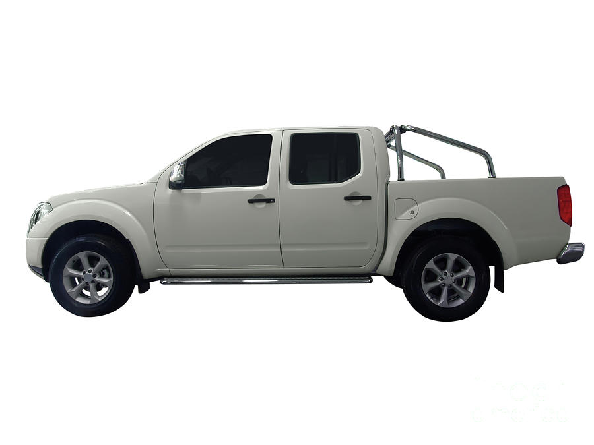
Motivation and Objectives
Our goal: Increase efficiency and accuracy of vehicle mass estimation pipeline
Our purpose: Reduced hardware cost, live mass estimation with reduced error
Our deliverables: Four optimized pipelines with Kalman filter integration
Mass: 1 ton
[2] Y. Zhou, Y. Pei, Z. Li, L. Fang, Y. Zhao, and W. Yi, “Vehicle weight identification system for spatiotemporal load distribution on bridges based on non-contact machine vision technology and deep learning algorithms,” Measurement, vol. 159, p. 107801, Jul. 2020, doi: https://doi.org/10.1016/j.measurement.2020.107801.

Slide 3
Dataset Technical Details
Dataset choice considerations:
We will focus on Single-Object Detection as our hardware platforms are heavily resource constrained and processing multiple detections will negatively impact our real-time performance on both the edge and cloud. Images should be of a single vehicle
The dataset must be large spanning several distinct vehicle body style categories
The dataset must contain several viewing angles of vehicles
We must be able to derive a Curb Weight value from the available information
For our project our group used the following publicly available datasets:
CompCars
This dataset contains 214,345 images of 1,687 car models from both web and surveillance-sources
This dataset was hierarchy organized in a folder for both images and labels: /{User_Root_Directory}/images/make_id/model_id/imageexample.jpg
.Txt files provided by author outlined car_type_id with small modifications: Car Types: ['MPV', 'SUV', 'sedan', 'hatchback', 'minibus', 'fastback', 'wagon', 'pickup', 'hardtop convertible', 'sports', 'crossover', 'convertible']. Where the first entry was labeled int(1) and 0/0.0 entries are unknown or uncategorized, this category was dramatically overrepresented and thus only the images with categorized car_type_id were retained leaving 76394 images and labels
An additional ‘attributes.txt’ file is included relating model_id to different vehicle features in the following: [‘model_id, maximum_speed, displacement, door_number, seat_number, car_type'].
Motivation: We selected this dataset primarily because of the large extent of represented vehicles at several distinct viewing angles. Additionally, each vehicle image was linked to individual text files with information about the Car Type and bounding box.
Linjie Yang, Ping Luo, Chen Change Loy, Xiaoou Tang. A Large-Scale Car Dataset for Fine-Grained Categorization and Verification, In Computer Vision and Pattern Recognition (CVPR), 2015. Link: http://mmlab.ie.cuhk.edu.hk/datasets/comp_cars/index.html
Carsheet.io
https://carsheet.io/ (Acquired dataset using a web scraping tool with permission from the original author given through email on Nov 16th)

Slide 4
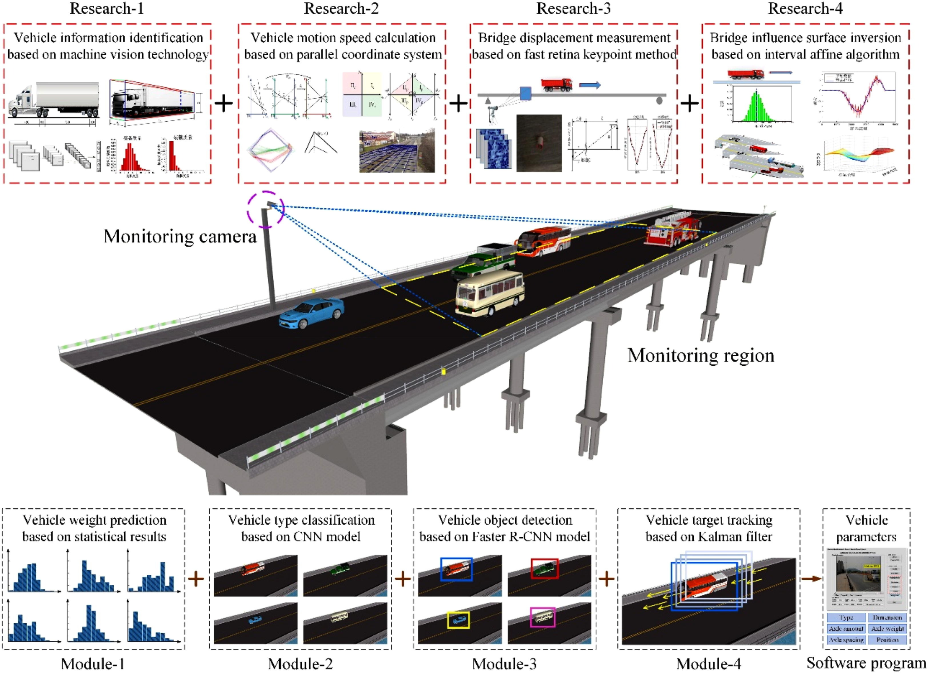
Technical Approach and Novelty
How is it done today, and what are the limits of current practice?
Frequently, two key components are necessary in vehicle tracking; a detection model and a tracking model [1].
Most Vehicle Tracking systems require the use of high-performance hardware
Poor performance in real-time applications induced by complex scenes and algorithm latency
Weight estimation of vehicles is done by type and output as a range
What is your approach (at a high level) and what is new about it?’
Programmatically our approach, will seek to replicate the overall structure of the proposed pipeline in [2], however, we will be implementing a Single-Stage Detector algorithm like “You Only Look Once” YOLOv4tiny and a Kalman filter attempts to utilize prior knowledge determined during our pipeline to estimate the mass of the vehicle on two different embedded platforms.
Combining Edge hardware with Cloud services to seek the most optimal system configuration when comparing cost, accuracy, and latency
[1] Azimjonov, J., Özmen, A. & Varan, M. “A vision-based real-time traffic flow monitoring system for road intersections,” Multimed Tools Appl 82, 25155–25174 (2023). https://doi.org/10.1007/s11042-023-14418-w
[2] Y. Zhou, Y. Pei, Z. Li, L. Fang, Y. Zhao, and W. Yi, “Vehicle weight identification system for spatiotemporal load distribution on bridges based on non-contact machine vision technology and deep learning algorithms,” Measurement, vol. 159, p. 107801, Jul. 2020, doi: https://doi.org/10.1016/j.measurement.2020.107801.

Slide 5
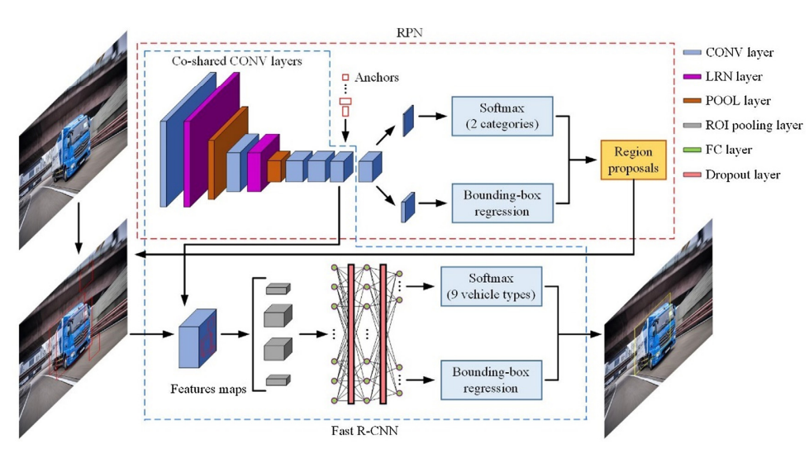
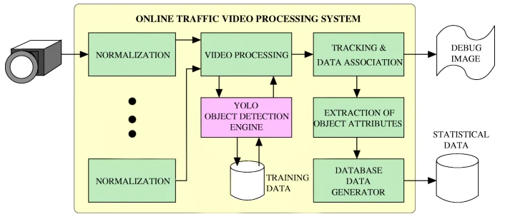
Model Methods
Reference Pipeline structure:
VGG-16 CNN:
Generates regions of interest in frame
Fast R-CNN:
Uses VGG-16 CONV layer to classify and detect vehicles in frame
Statistical Correlation of Type to weight range
Parameters: Axle Spacing, Global Weight, Front & Rear axle weight
Kalman Filter:
Updated with Fast R-CNN information to produce a bounding box
Finalized Pipeline structures:
Tensorflow Lite YOLOv5 Model
Correlation between model_id and car_type to determine weight metric
Case 1 Pi-Edge Iot:
(96, 96) Image
Applied Quantization
Logitech External Camera
Case 2 Pi-Cloud:
(320, 320) Image Input
Rtsp Stream Server Enabled
Trained using the Tensorflow Github Repository
Custom Config: YOLO_NAS_S_UINT8 (not yet evaluated)

Slide 6
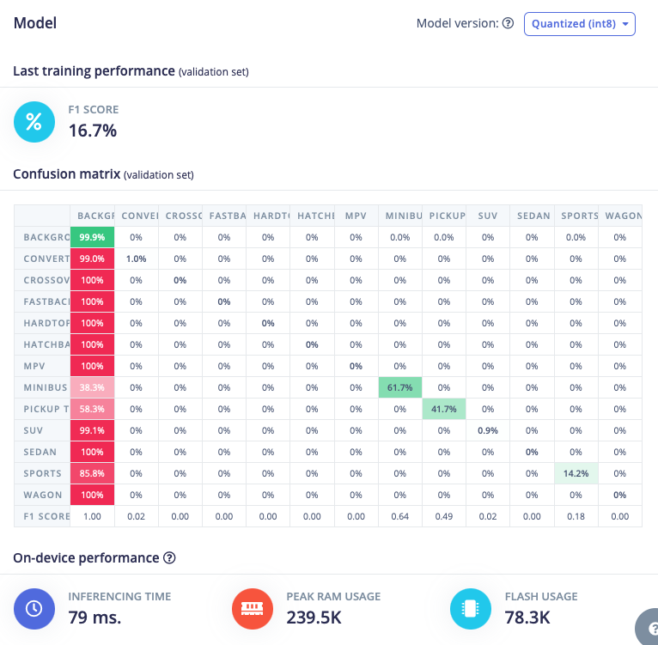
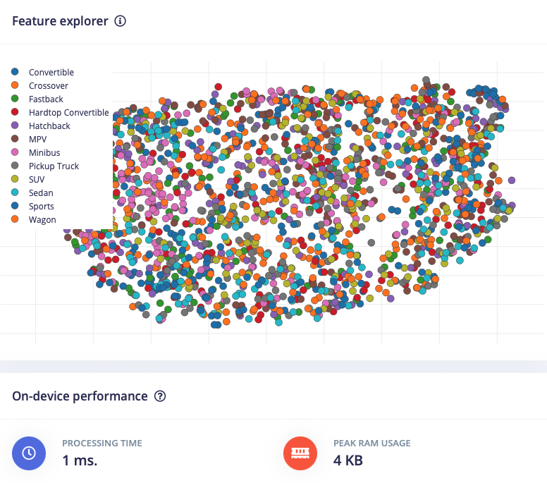
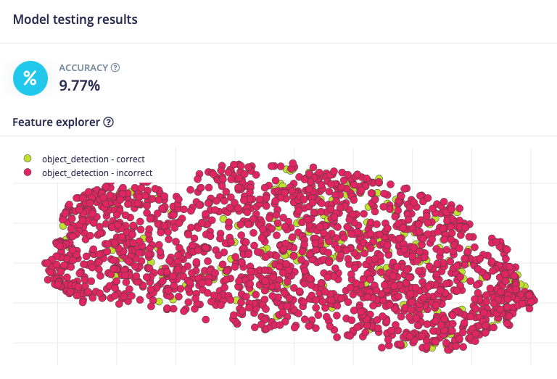
Nicla Vision FOMO model
Optimized for very light edge devices
Nicla Vision Resources:
2MB of Flash memory and 1MB of RAM
Model needed to be very lightweight
Led to being much less accurate

Slide 7
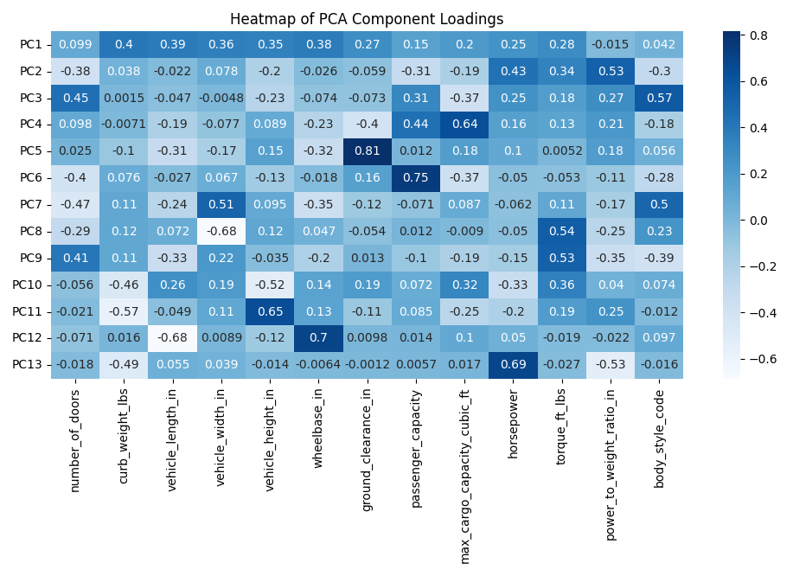
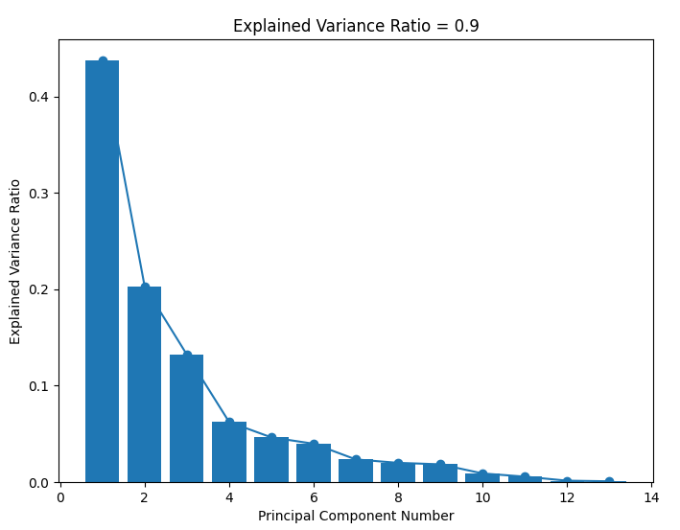
Current Project Status:
Selected two hardware platforms: Raspberry Pi 4b and Nicla Vision
Sourced image dataset from KITTI, CompCars and ImageNet
Sourced statistical data on vehicles by model of 1990 - 2023 (60,000+ entries)
Principal Component Analysis (PCA)
Explained Variance = 90%
Object detection running on all platforms
Next Project Steps:
Source Data from the group behind our reference pipeline.
Establish baseline performance metrics for accuracy and latency on hardware /w reference dataset & public dataset
Integrate optimized pipeline components for both cases
Repeat evaluation with optimized pipelines

Slide 8
Evaluation and Metrics
Three major metrics for evaluation:
Latency: time to compute
Cost: Evaluate cost efficiency
Accuracy: Find most accurate implementation
}
cloud
Raspberry Pi4 implementation
edge
Baseline implementation
Kalman Filter implemented
cloud
Nicla Vision implementation
edge

Slide 9
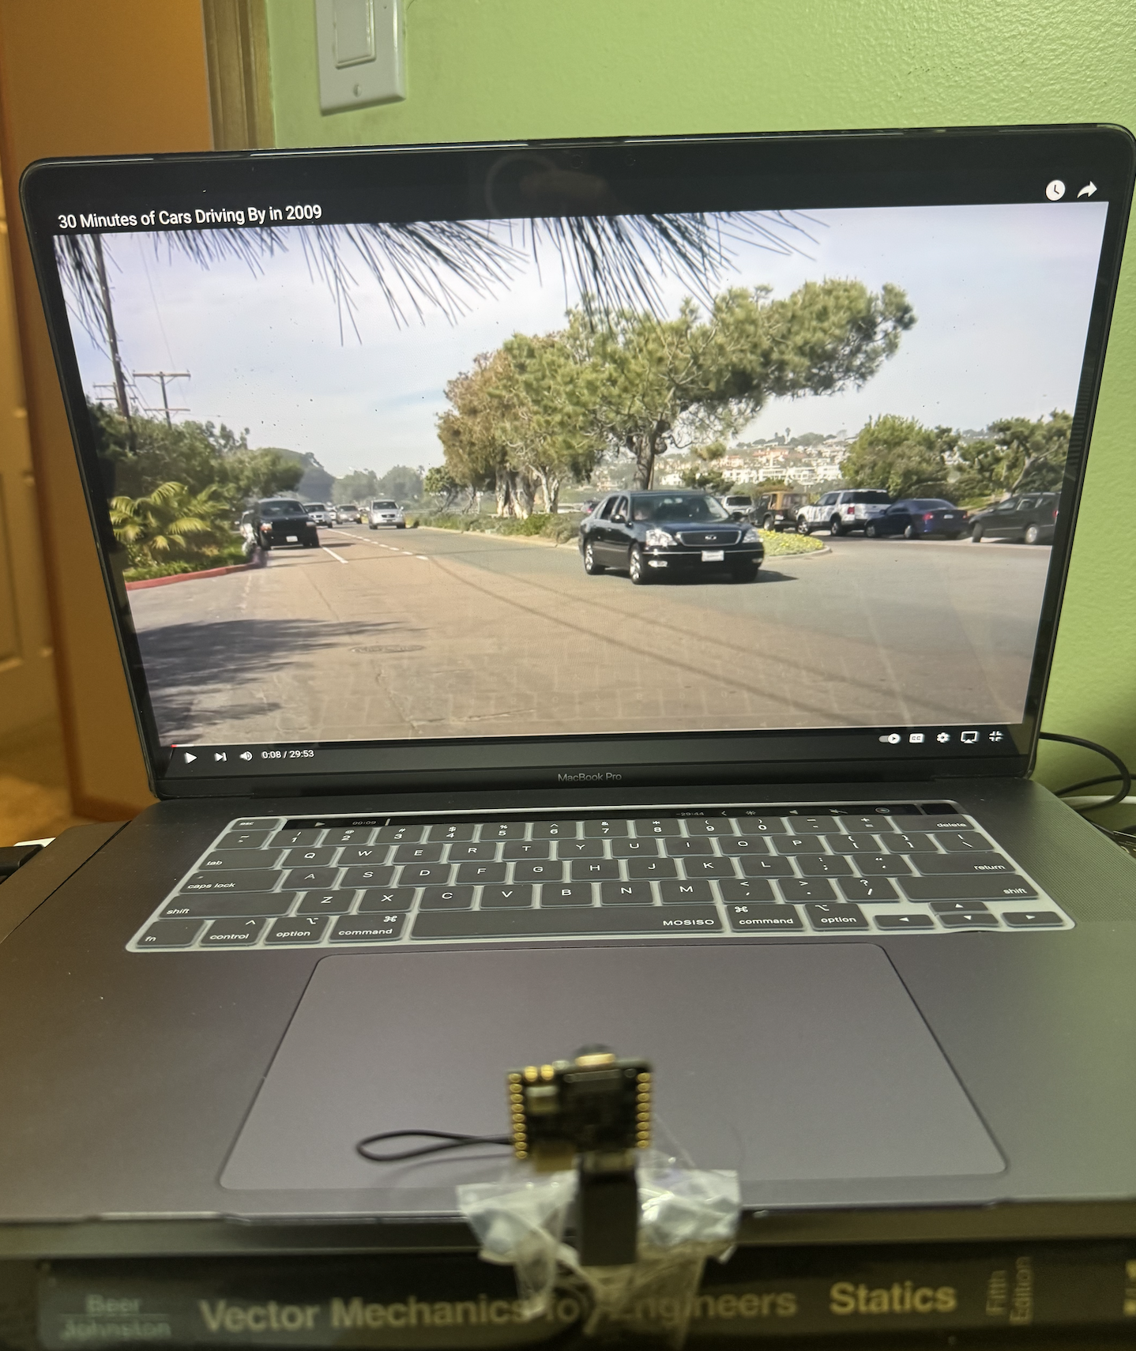
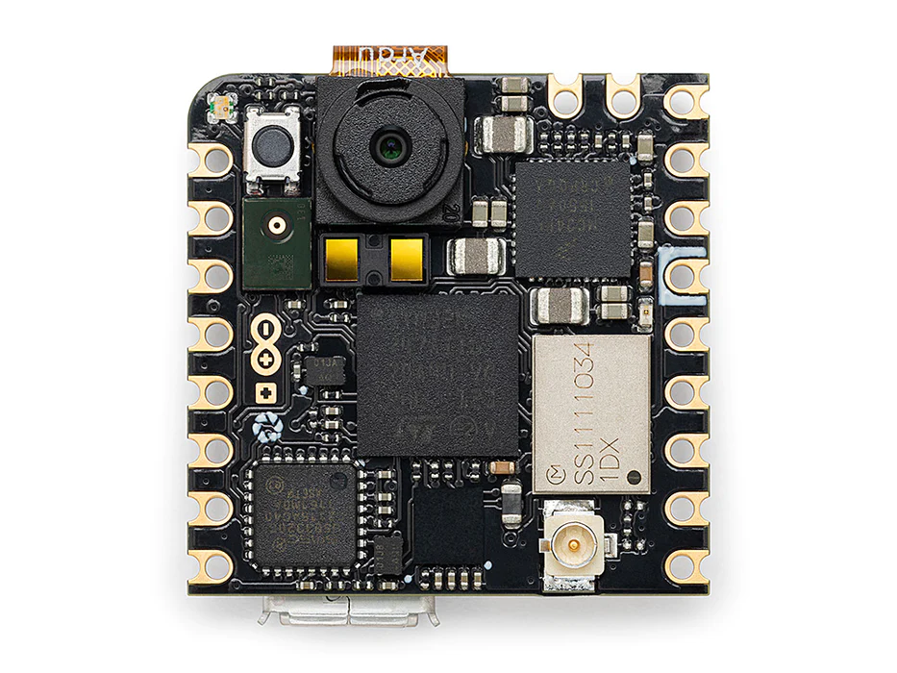

Technical methodology (Nicla)
Edge:
Software: openMV & Edge Impulse
Hardware: Nicla Vision
Cloud:
Software: python3 + rtsp stream cloud machine
Hardware: nicla
Edge: camera feed, object detection, and estimation occur locally
Cloud: camera feed ran from nicla, object detection, and estimation occur virtually or on local machine

Slide 10
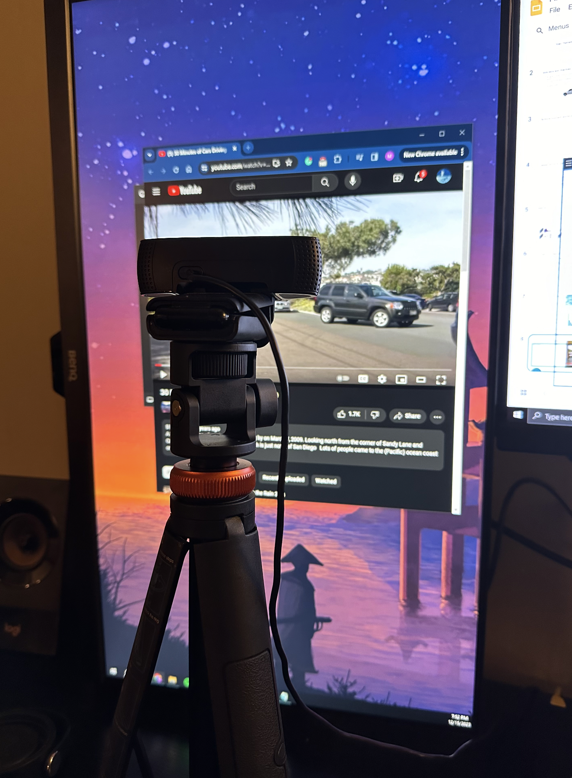
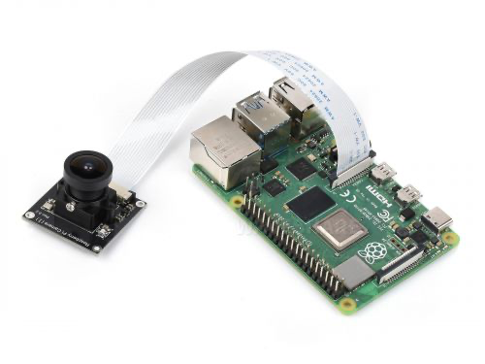
Technical Methodology (RaspberryPi)
Edge:
Software: Python3, openCV, TensorFlow
Hardware: Rpi4 + camera
Cloud:
Software: python3 + rtsp stream cloud machine
Hardware: Rpi4 + camera
Edge: camera feed, object detection, and estimation occur locally
Cloud: camera feed ran from nicla, object detection, and estimation occur virtually or on local machine

Slide 11


Cloud Logic

Slide 12
Future Works
Implement mass estimation optimization
Incorporate a lighter weight model on the edge, as memory size has become one of our most apparent restrictions
Incorporate binary quantization rather than or in addition to quantization aware training to further reduce model size
Use Executorch or equivalent to conduct model tests in different framework formats like ONNX,
Create a completely reworked model that relies on custom Pytorch Dataloaders and Dataset Parameters, to train a custom model that
Further test tensorflow lite rather than tensorflow + further quantization + pruning methods

Slide 13
Work Split
Dataset Construction - Marc Hernandez
Model Investigation Research - Marc Hernandez
Mass estimation query - Marc Hernandez
Hardware + software Implementations (Cloud & Edge) - Tilboon Elberier
Nicla Vision edge compute model development - Tilboon Elberier

Slide 14

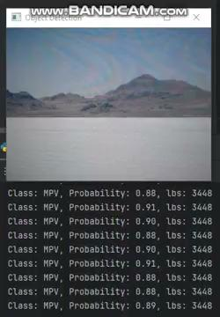
Rpi on the Cloud

Slide 15
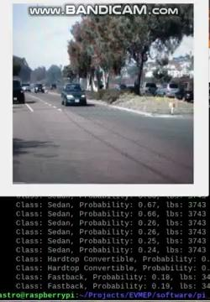
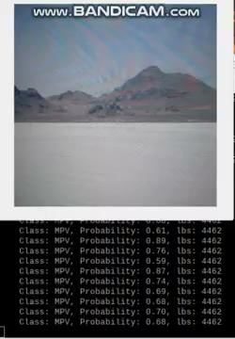
Rpi on the Edge

Slide 16
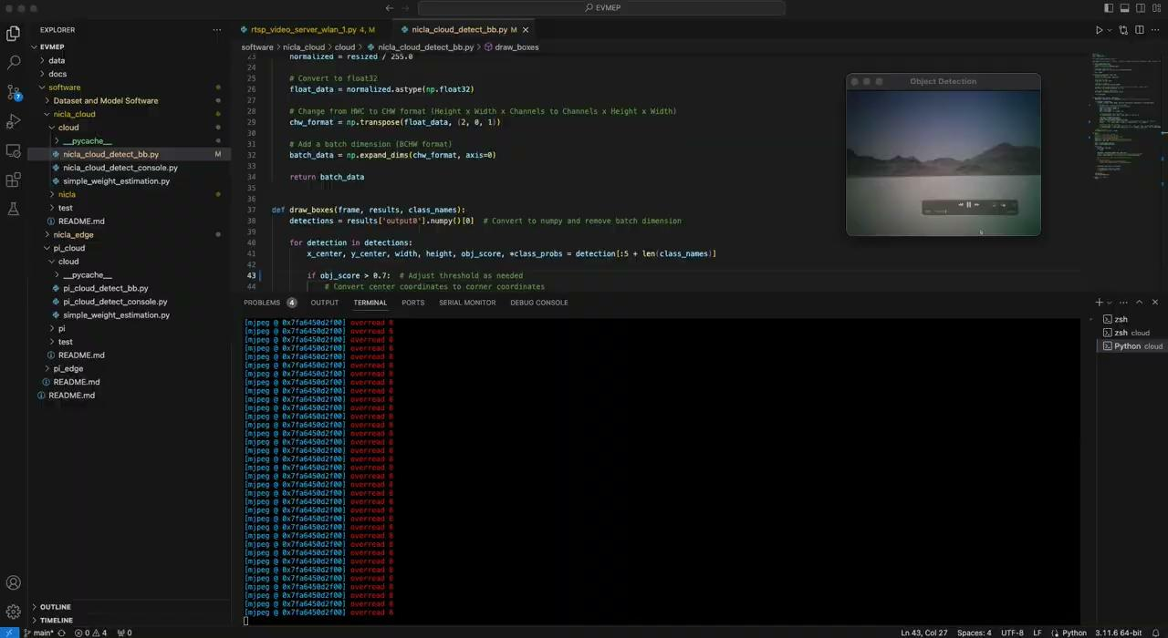
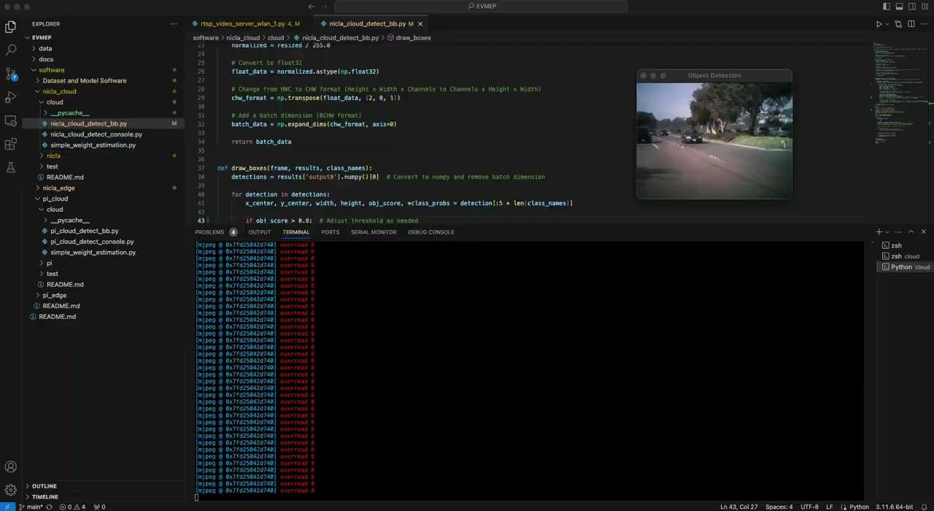
Nicla in the Cloud

Slide 17
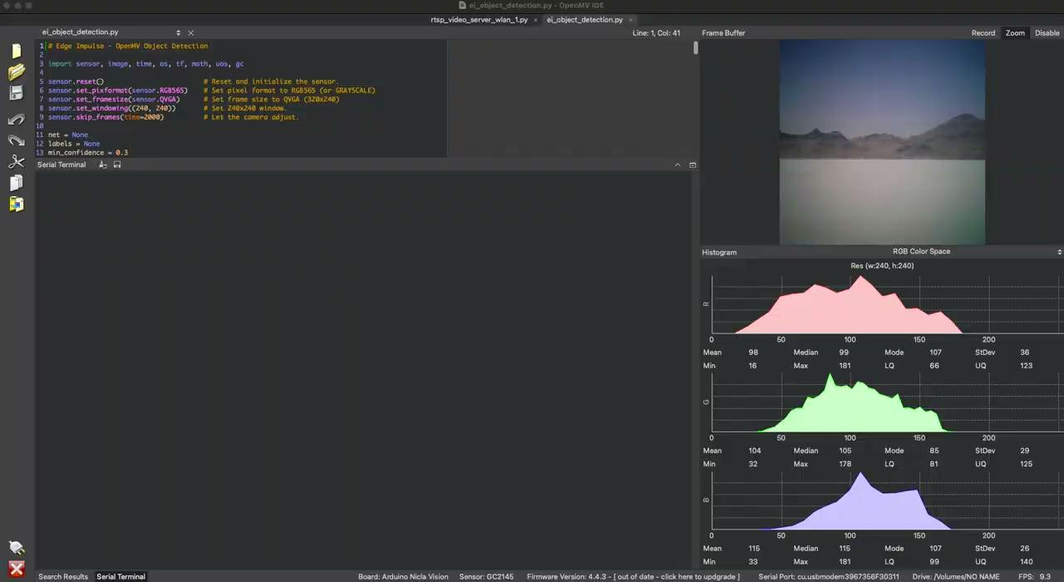
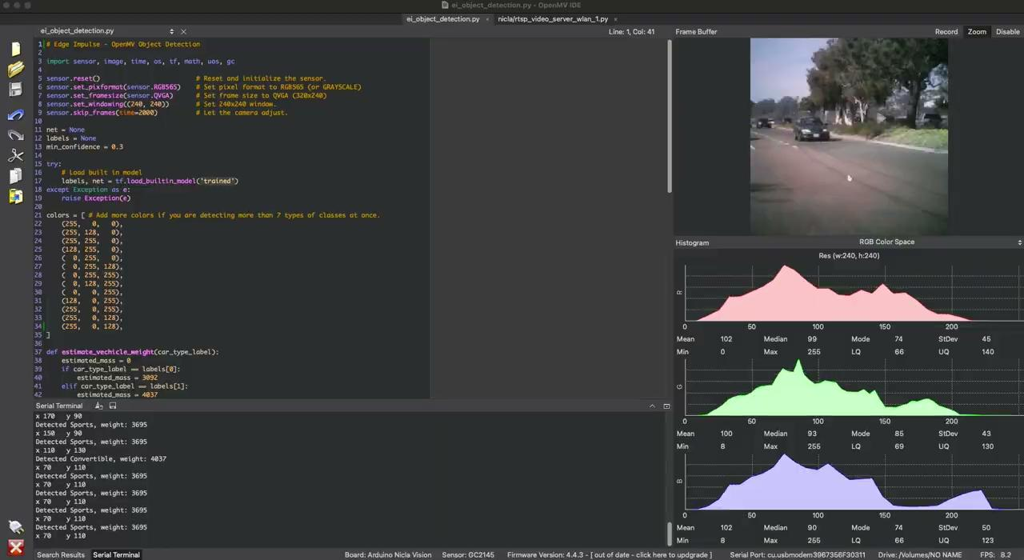
Nicla on the Edge

Slide 18
References
[1] M. Loni, S. Sinaei, A. Zoljodi, M. Daneshtalab, and M. Sjödin, “DeepMaker: A multi-objective optimization framework for deep neural networks in embedded systems,” Microprocessors and Microsystems, vol. 73, p. 102989, Mar. 2020, doi: https://doi.org/10.1016/j.micpro.2020.102989.
[2] Y. Zhou, Y. Pei, Z. Li, L. Fang, Y. Zhao, and W. Yi, “Vehicle weight identification system for spatiotemporal load distribution on bridges based on non-contact machine vision technology and deep learning algorithms,” Measurement, vol. 159, p. 107801, Jul. 2020, doi: https://doi.org/10.1016/j.measurement.2020.107801.
[3] Azimjonov, J., Özmen, A. & Varan, M. “A vision-based real-time traffic flow monitoring system for road intersections,” Multimed Tools Appl 82, 25155–25174 (2023). https://doi.org/10.1007/s11042-023-14418-w
[4] M. Magrini, D. Moroni, G. Palazzese, G. Pieri, G. Leone and O. Salvetti, "Computer Vision on Embedded Sensors for Traffic Flow Monitoring," 2015 IEEE 18th International Conference on Intelligent Transportation Systems, Gran Canaria, Spain, 2015, pp. 161-166, https://doi.org/10.1109/ITSC.2015.35.
[5] Diwan, T., Anirudh, G. & Tembhurne, J.V. “Object detection using YOLO: challenges, architectural successors, datasets and applications,” Multimed Tools Appl 82, 9243–9275 (2023). https://doi.org/10.1007/s11042-022-13644-y
[6] A. Kuznetsova et al., “The Open Images Dataset V4,” International Journal of Computer Vision, Mar. 2020, doi: https://doi.org/10.1007/s11263-020-01316-z.
[7] A. Paszke et al., “PyTorch: An Imperative Style, High-Performance Deep Learning Library,” arXiv.org, 2019. https://arxiv.org/abs/1912.01703
[8] Arduino IDE 2 (2022) Arduino S.r.l. [Online] https://www.arduino.cc/
[9] OpenMV IDE (v4.0.14) OpenMV, LLC [Online] Accessed: Oct 28, 2023 https://openmv.io/
[10] OpenCV (4.8.0) Open Source Computer Vision Library [Online] Accessed: Oct 28, 2023 https://opencv.org/

